Slide 1
www.o-pitblast.com

Slide 2
How to use Non-Electric timing (with deck charging)

Slide 3
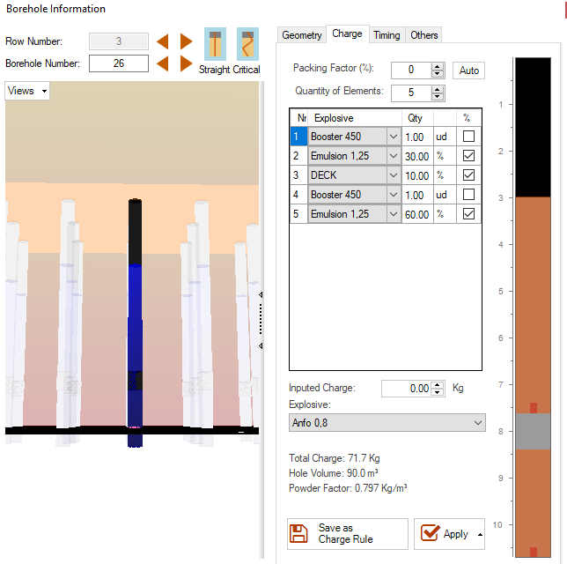
Holes design charge (with decks)
Stemming
Emulsion
Deck
Emulsion

Slide 4
Deck module (non-electric)
4. Connect decks
1. Show decks on the screen
2. Add connectors and detonators
3. Sort (from bottom or top) and select connection mode

Slide 5
1. Show decks on the screen
Option to visualize decks on the boreholes

Slide 6
2. Add connectors and detonators
Detonators
Add detonators
Add connectors
Connectors
Save configuration and reload previous configuration

Slide 7
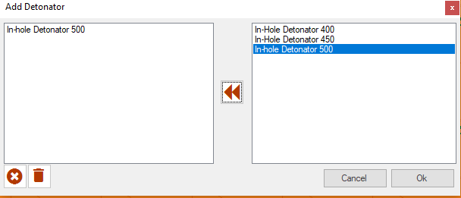
2. Add connectors and detonators
List of in-hole detonators
Delete selected
Add from list the detonators that are going to be used.
Delete all

Slide 8
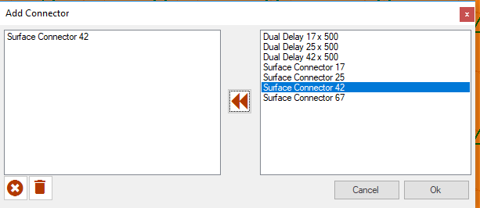
2. Add connectors and detonators
List of connectors
Delete selected
Add from list the connectors that are going to be used.
Delete all

Slide 9
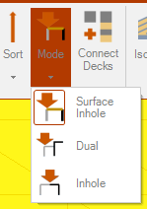
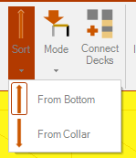
3. Sort (from bottom or top) and select connection mode
Timing decks from:
Bottom of the hole
Collar of the the hole
Select connection mode (see next slide)

Slide 10
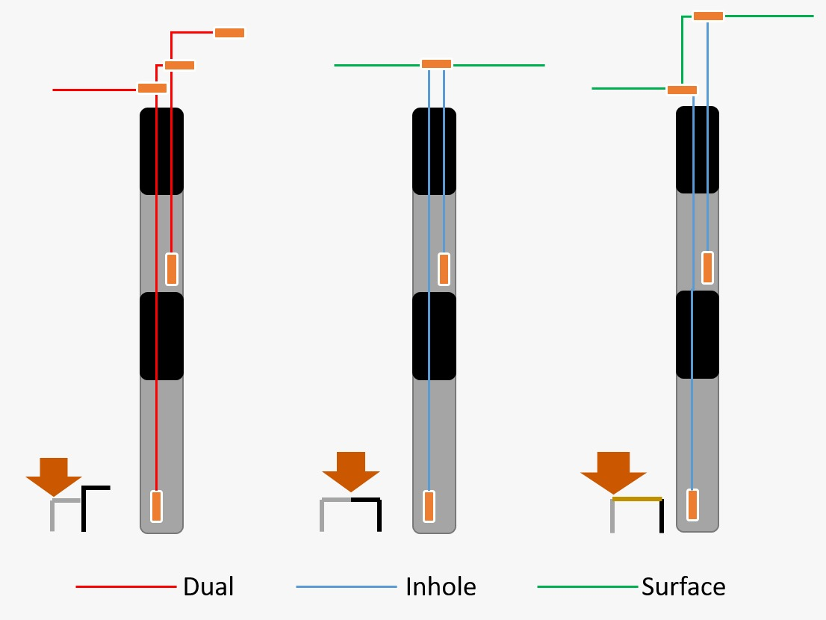
3. Sort (from bottom or top) and select connection mode

Slide 11
How to connect decks ?

Slide 12
1. How to connect in “Surface In-hole” mode: 2 decks
Add the in-hole detonator and surface connector that it’s going to be used.

Slide 13
1. “Surface Inhole” mode: 2 decks
Select “add timing” and drag the mouse between holes
Decks are primed with 17ms between them and with an in-holes of 500ms.

Slide 14
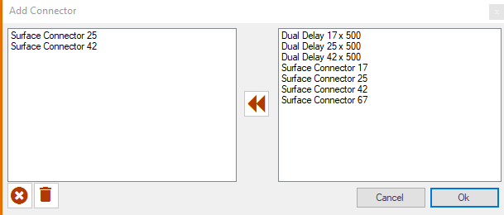
1.1 How to connect in “Surface In-hole” mode: 3 or more decks
Add the in-hole detonators and surface connectors that are going to be used.
REMEMBER: that the order that you gave here it’s the order that the decks are going to be timed.

Slide 15
1.1 “Surface Inhole” mode: 3 or more decks
NOTE: If there are more decks than the number of added detonators, the extra on the bottom will assume the last detonator of the list.
Decks are connected (top to down) by the order given when “adding connectors”

Slide 16
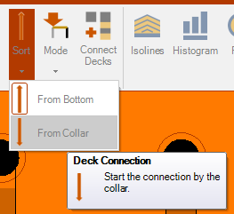
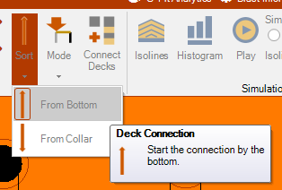
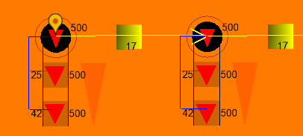
1.1 “Surface Inhole” mode: 3 or more decks
Depending on the order that the user chooses (From Bottom or From Top): the decks will initiate differently

Slide 17
2. How to connect in “Dual” mode: 2 decks
Add the dual connector that it’s going to be used.

Slide 18
2. How to connect in “Dual” mode: 2 decks
it’s important to refer that when using dual mode, the detonator that it’s going to be used to connect to the next hole, must be the same used in the “Non-Electric Detonator” tab.
Also, since the user is using the Dual Delay, the “In Hole Detonator” must be on the option “None”

Slide 19
2. How to connect in “Dual” mode: 2 decks
Select “add timing” and drag the mouse between holes
Decks are connected with Dual Detonators of 25x500ms.

Slide 20
3. How to connect in “In-hole” mode: 2 decks
Add the in-hole detonator that it’s going to be used.

Slide 21
3. How to connect in “In-hole” mode: 2 decks
Select “add timing” and drag the mouse between holes
The decks are primed with 500ms and 450ms, respectively. Between hole It’s used the surface connector defined on the “Non-Electronic Detonator” tab.

Slide 22
4. Video-example

Slide 23
How to use Electronic timing (with deck charging)

Slide 24
Holes design charge (with decks)
Stemming
Emulsion
Deck
Emulsion

Slide 25
Deck module (electronic)
1. Define delay between decks
2. Define the delay between detonators inside the same deck

Slide 26
1. Delay inter decks
Define timing normally
Choose delay inter decks
In this case (delay of 10ms inter decks): all decks are with 10ms of delay

Slide 27
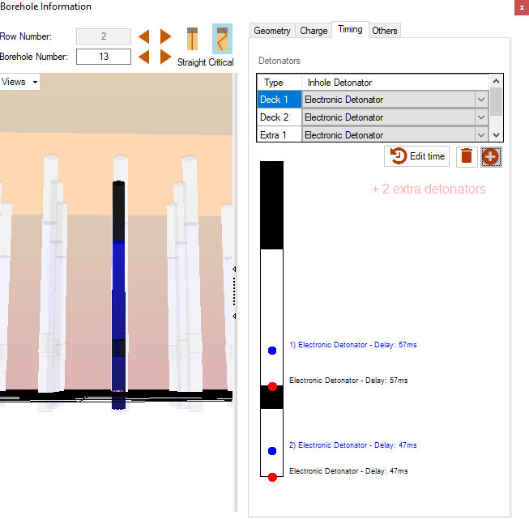
2. Delay inner decks
When the user has extra detonators on the same deck
Extra detonator on top deck
Extra detonator on bottom deck

Slide 28
2. Delay inner decks
Define timing normally
Choose delay inter decks
In this case (delay of 5ms inner decks): all inner decks are with 5ms of delay

Slide 29
4. Video-example

Slide 30
www.o-pitblast.com

